Slide 1
Optimal Charge Station Selection Strategy
Xun(Perry) Liu
12/17/2019
Notes:
https://spaces.telenav.com:8443/display/TAS/EV+demo+based+on+OSRM

Slide 2
Agenda
Introduction about OSRM
Problem Description
Version 1 -> Version 2 -> Version 3
Future

Slide 3

What is OSRM

Slide 4
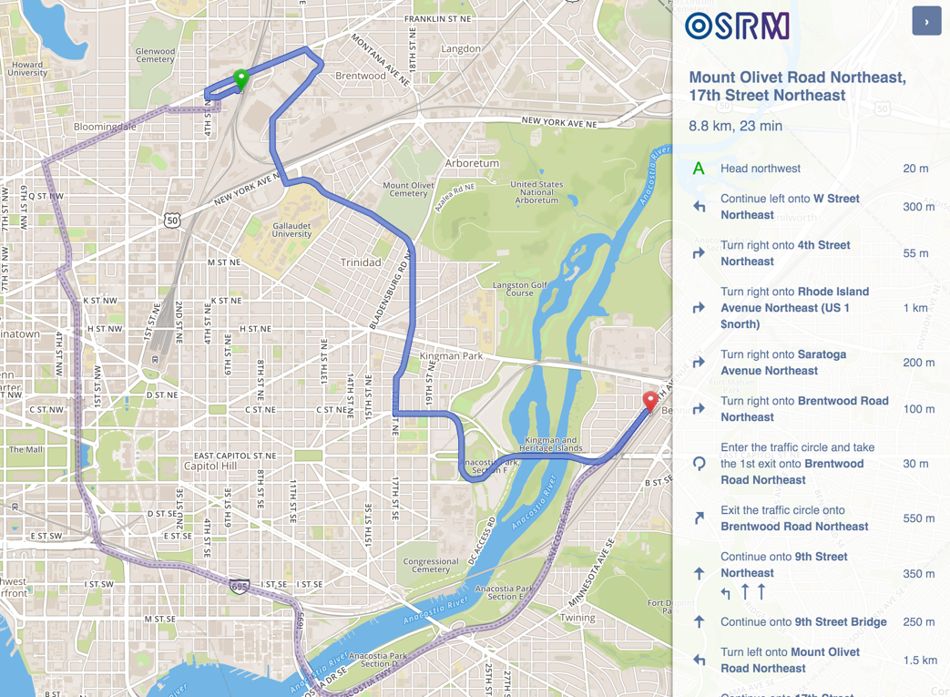
What OSRM could do
- Lowest cost path and turn by turn navigation

Slide 5
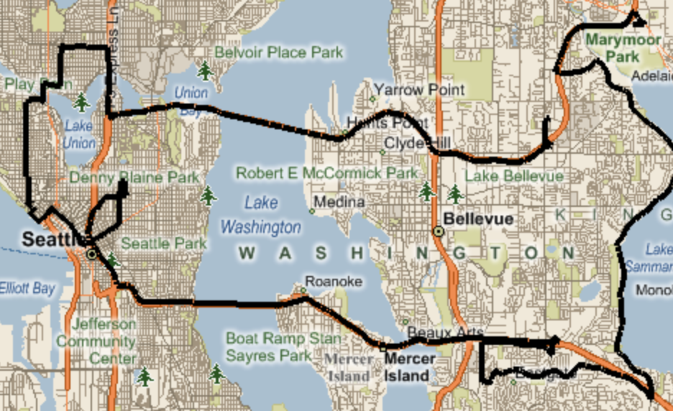
What OSRM could do
- Shortest path and turn by turn navigation
- MapMatching, enable user to do MapMaking

Slide 6
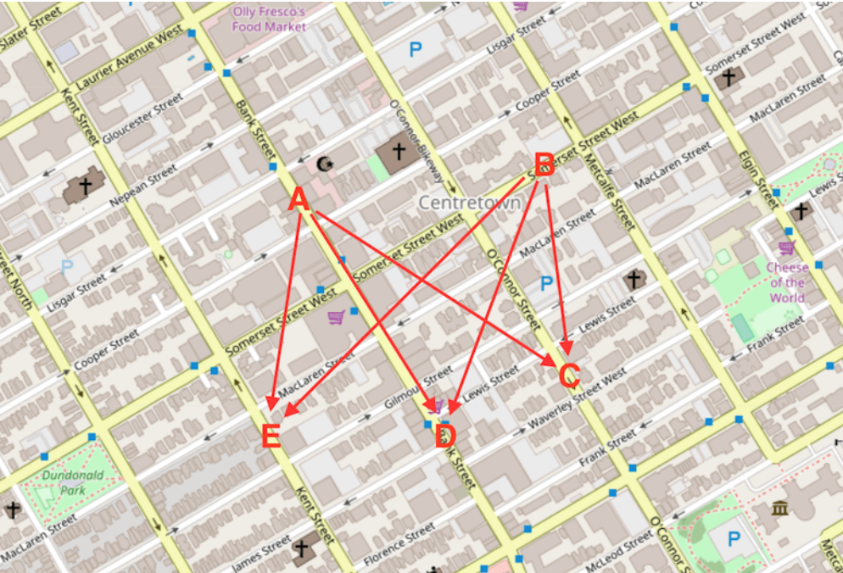
What OSRM could do
- Shortest path and turn by turn navigation
- MapMatching, enable user to do MapMaking
- Table service

Slide 7

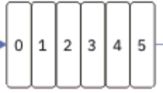
How OSRM work with Telenav Stack
HERE
OSRM Tech Stack
Direction Service
OSRM Data Compiler
OSM
PBF
Matching Service
OSRM Graph Data
OSRM Routing Engine
TomTom
Table Service
TomTom Traffic
Tile Service

Slide 8
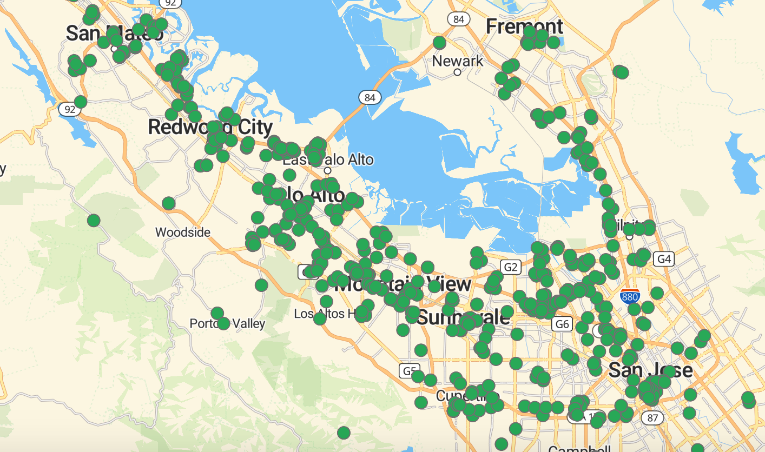
Problem description
Smart Charge station selection
for long distance route
Join Na Team

Slide 9
Version 1: Proof of concept solution
Version 2: Optimize for 1 ~ 2 charge station change
Version 3: Optimize for long route and dynamic information

Slide 10
User Story
As a user, if I drive with electric vehicle, the solution could help to find suitable charge station along the route to help me arrive my destination if the distance is longer than my current energy mileage.

Slide 11
Version 1
Step 1. Pass in destination and user's current energy level, location

Slide 12
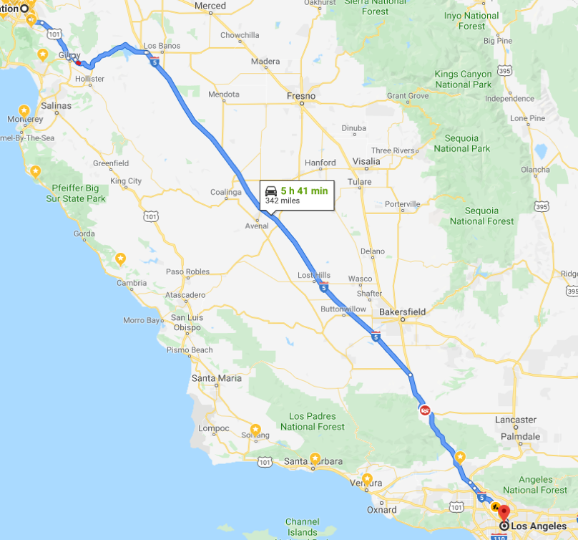
Version 1
Step 1. Pass in destination and user's current energy level, location
Step 2. Calculate route between origin and destination

Slide 13
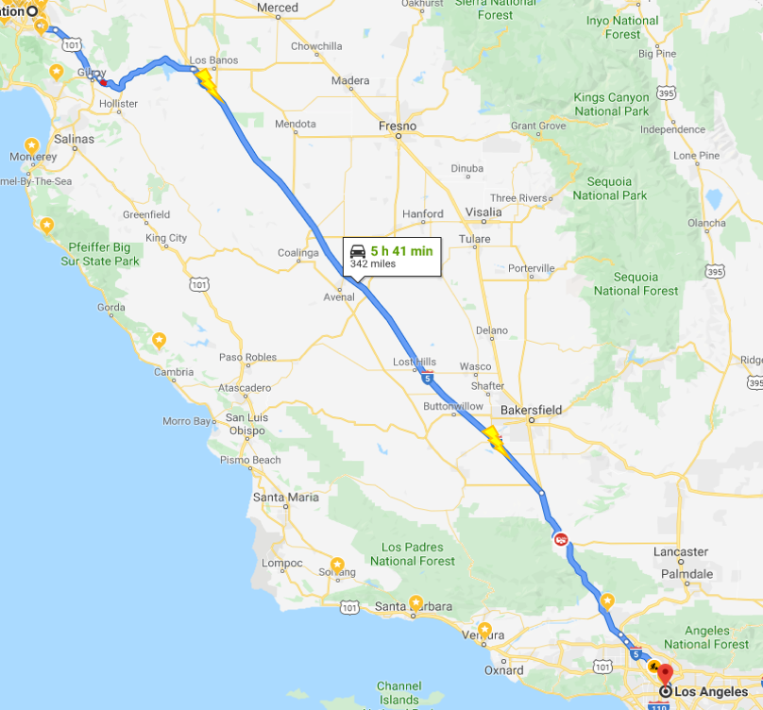
Version 1
Step 1. Pass in destination and user's current energy level, location
Step 2. Calculate route between origin and destination
Step 3. Find the route range where energy level is low

Slide 14
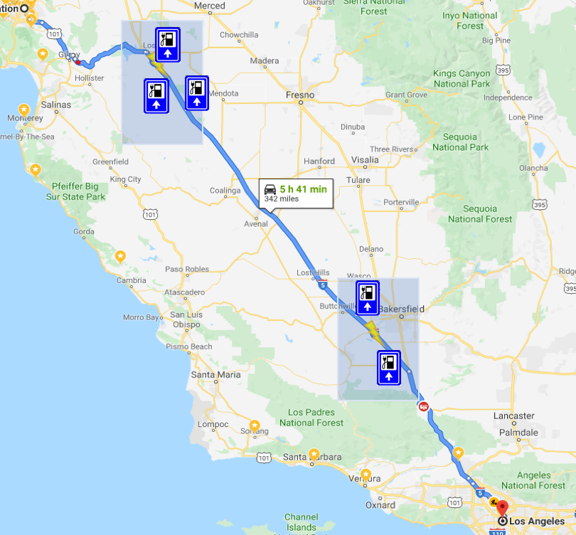
Version 1
Step 1. Pass in destination and user's current energy level, location
Step 2. Calculate route between origin and destination
Step 3. Find the route range where energy level is low
Step 4. Find charge station in certain bounding box along the route

Slide 15
Version 1
Step 1. Pass in destination and user's current energy level, location
Step 2. Calculate route between origin and destination
Step 3. Find the route range where energy level is low
Step 4. Find charge station in certain bounding box along the route
Step 5. Calculate fastest route between different range.(Need to guarantee each range at least has one candidate has energy to reach next stage.)

Slide 16
Version 1
Step 1. Pass in destination and user's current energy level, location
Step 2. Calculate route between origin and destination
Step 3. Find the route range where energy level is low
Step 4. Find charge station in certain bounding box along the route
Step 5. Calculate fastest route between different range
Step 6. Pick the best combination with earliest arrival time. (Please note each charge station could have multiple charge time <-> energy level pair.)

Slide 17
Version 1
Step 1. Pass in destination and user's current energy level, location
Step 2. Calculate route between origin and destination
Step 3. Find the route range where energy level is low
Step 4. Find charge station in certain bounding box along the route
Step 5. Calculate fastest route between different range
Step 6. Pick the best combination with earliest arrival time.
Step 7. Generate result and make charge station candidates as way points.

Slide 18
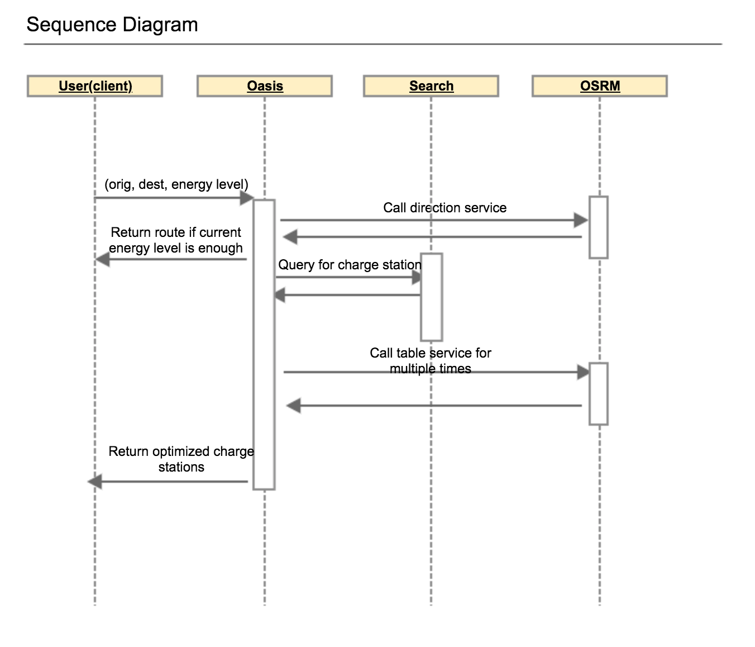
Version 1
Step 1. Pass in destination and user's current energy level, location
Step 2. Calculate route between origin and destination
Step 3. Find the route range where energy level is low
Step 4. Find charge station in certain bounding box along the route
Step 5. Calculate fastest route between different range
Step 6. Pick the best combination with earliest arrival time.
Step 7. Generate result and make charge station candidates as way points.

Slide 19
Version 1: Proof of concept solution
Version 2: Optimize for 1 ~ 2 charge station change
Version 3: Optimize for long route and dynamic information

Slide 20
Multi-criteria Result
ETA
Charge Station Change Count
Price
Waiting time
Energy level(distance)
Curve
…
Route 1 takes 2 charge station, need 1 hour 40 minutes
Route 2 takes 1 charge station, need 2 hours

Slide 21
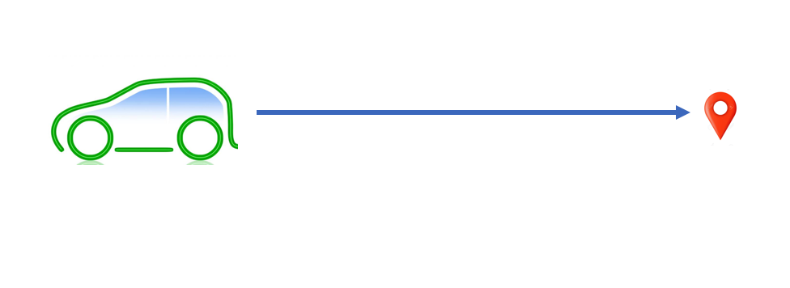
User has enough energy to reach destination

Slide 22
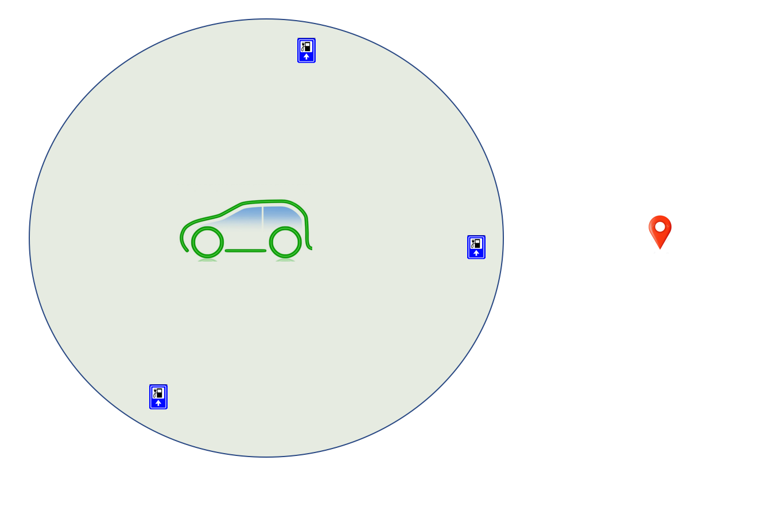
User need one charge station to reach destination

Slide 23
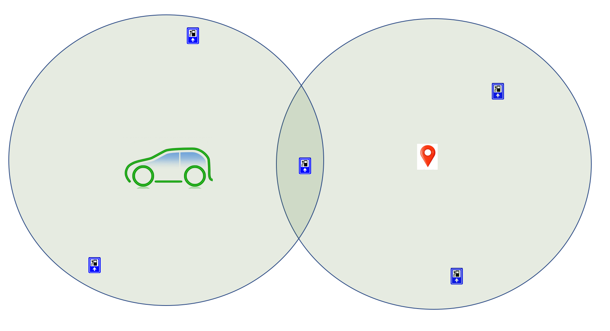
User need one charge station to reach destination

Slide 24
What if one charge station is not enough to reach dest

Slide 25
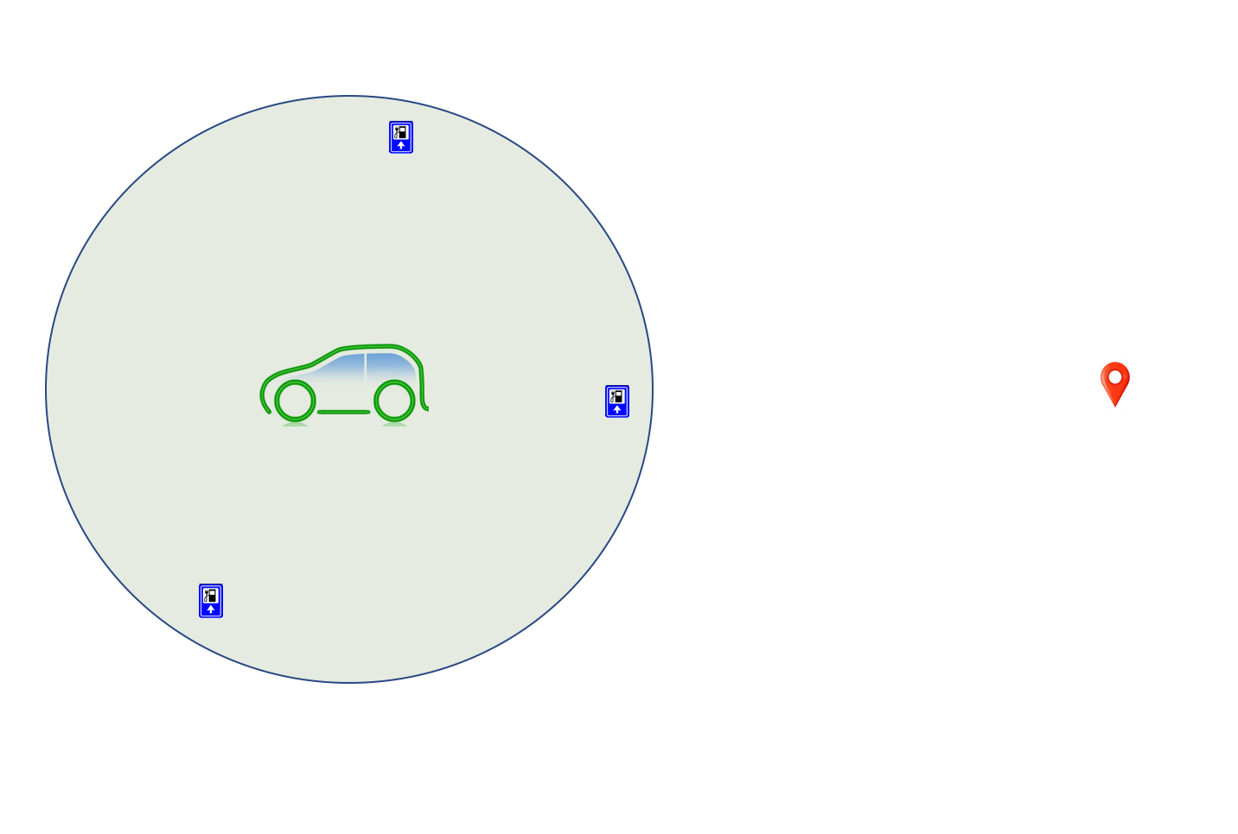

Slide 26
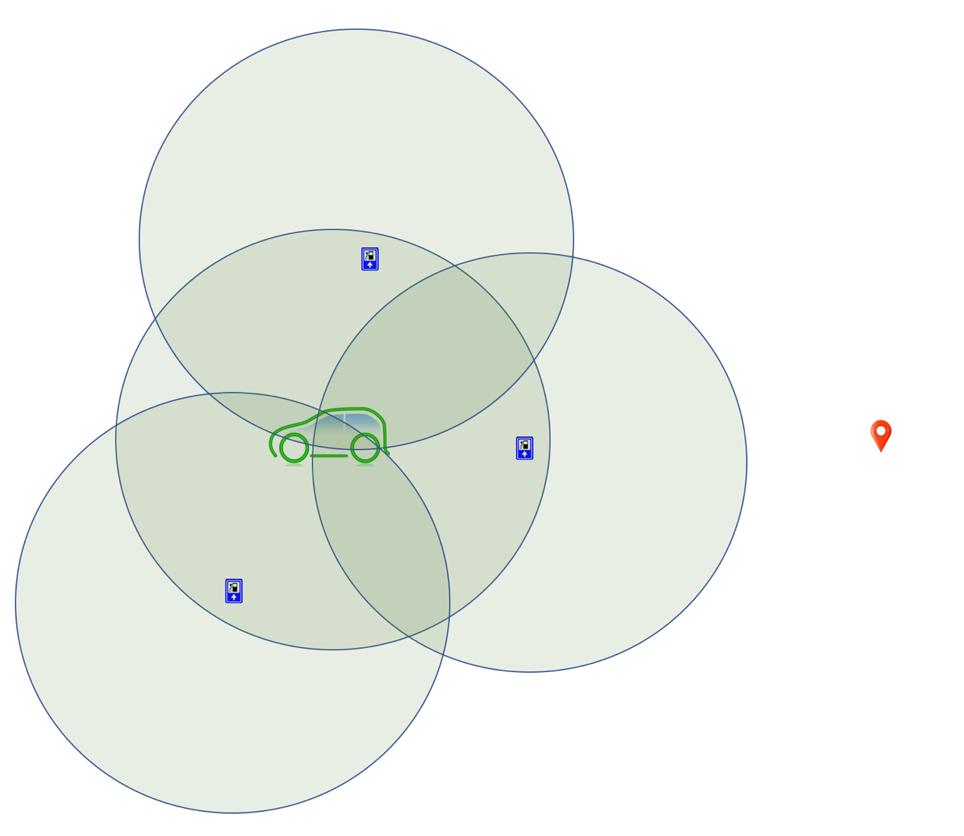

Slide 27
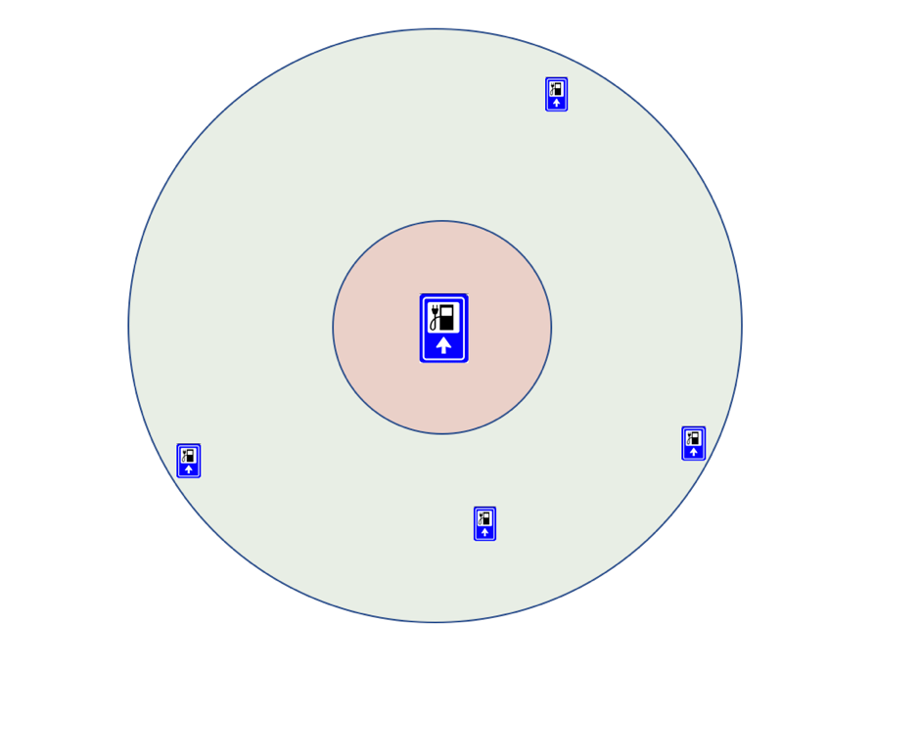
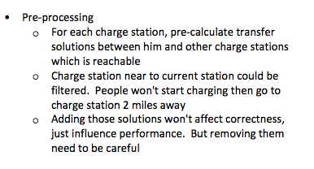
Inspired by transfer pattern

Slide 29
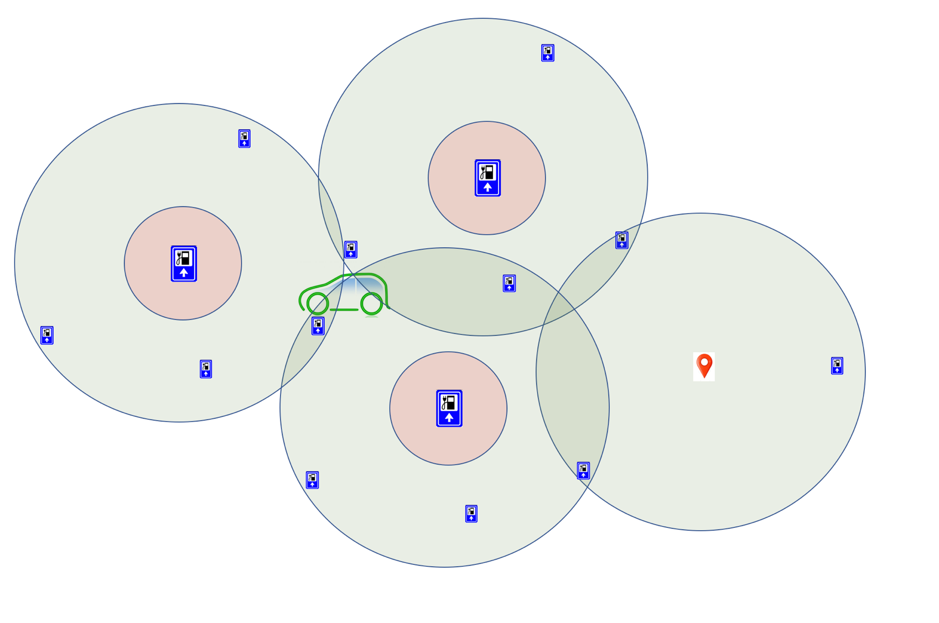
Inspired by transfer pattern

Slide 30
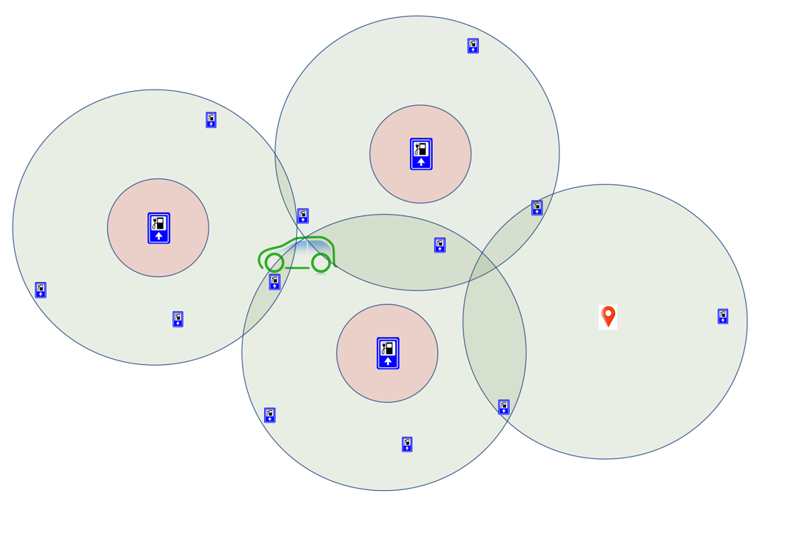
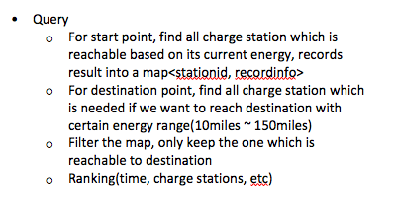
Inspired by transfer pattern

Slide 31
Pros & Cons
- Quick query time for short & medium distance route
- Could not handle long distance
- We could also add two transfers for each charge station
- Hard to handle dynamic information like charge station waiting time, traffic changes which affect pre-calculated transfer pattern
- Most user just need 1 change or 2 change to reach destination
- Consider multiple curve will make it complex

Slide 32
Version 1: Proof of concept solution
Version 2: Optimize for 1 ~ 2 charge station change
Version 3: Optimize for long route and dynamic information

Slide 33
Inspired by scalable transfer pattern and CRP
Notes:
https://ai.googleblog.com/2016/03/an-update-on-fast-transit-routing-with.html

Slide 34
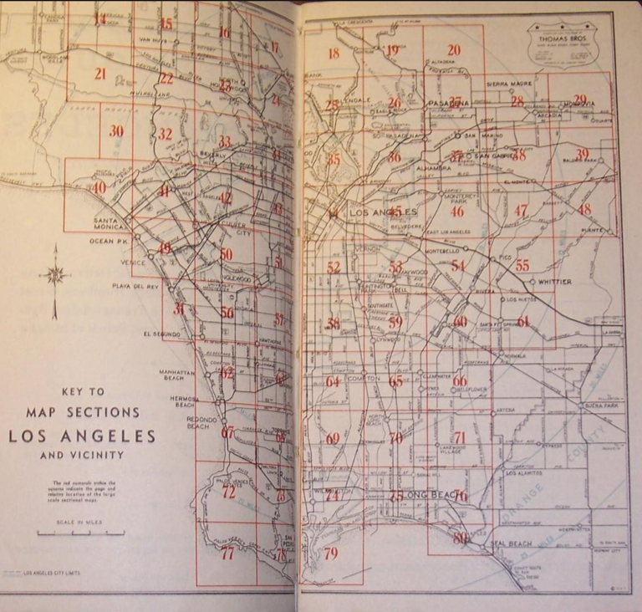
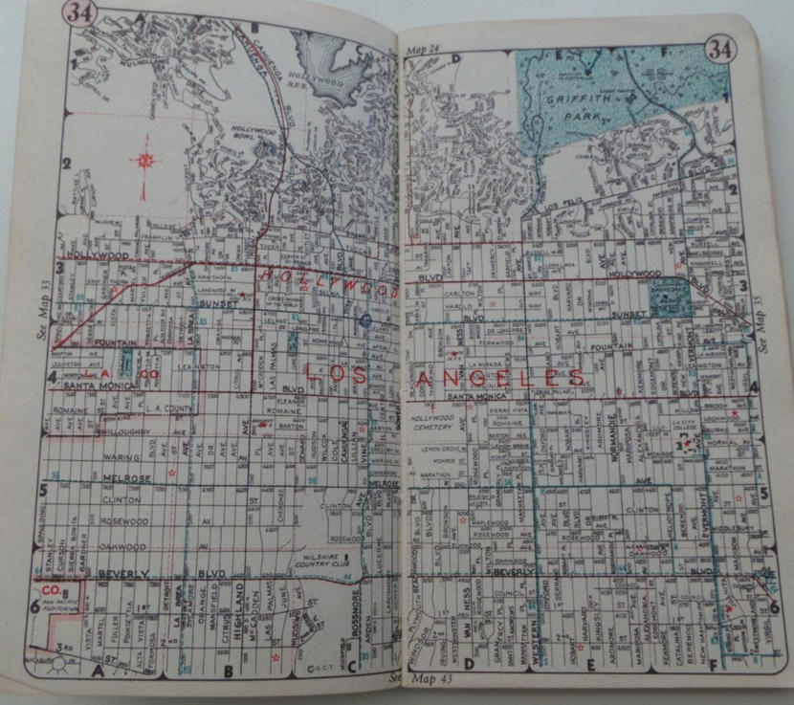
Thomas Guide
Notes:
Picture layout

Slide 35
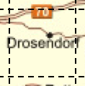
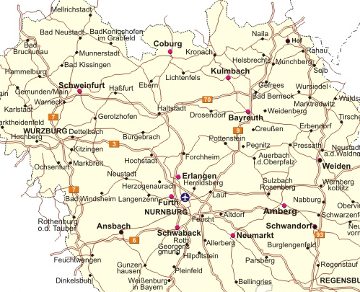
Access Points
Partition the graph
Access Points
Access Points

Slide 36
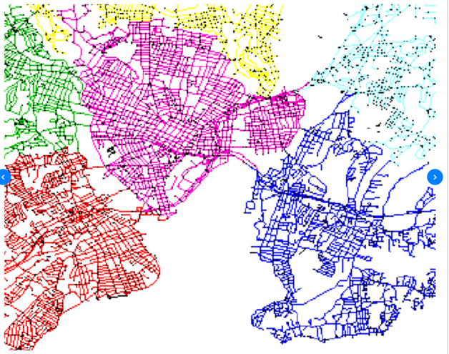
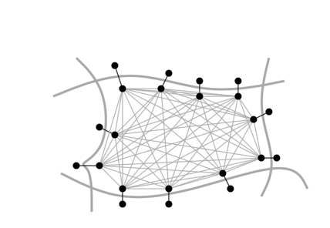
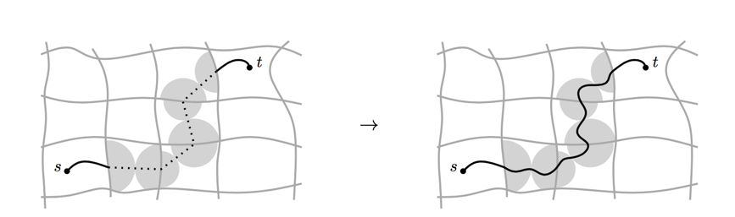
Customizable Route planning
Step 1: Graph preprocessing
Graph partition, preprocessing, hours
Step 2: Customization
Apply dynamic information with cost model
Each round of traffic update, seconds
Step 3: Query
Real time, per request, mili-seconds

Slide 37
Difference with Road network: Dynamic Energy
What if I pre-defined some energy level when reaching the boarder nodes?
Like, (5 miles, 50 miles, 100 miles, 150 miles, 200 miles)
Notes:
https://ai.googleblog.com/2016/03/an-update-on-fast-transit-routing-with.html

Slide 38
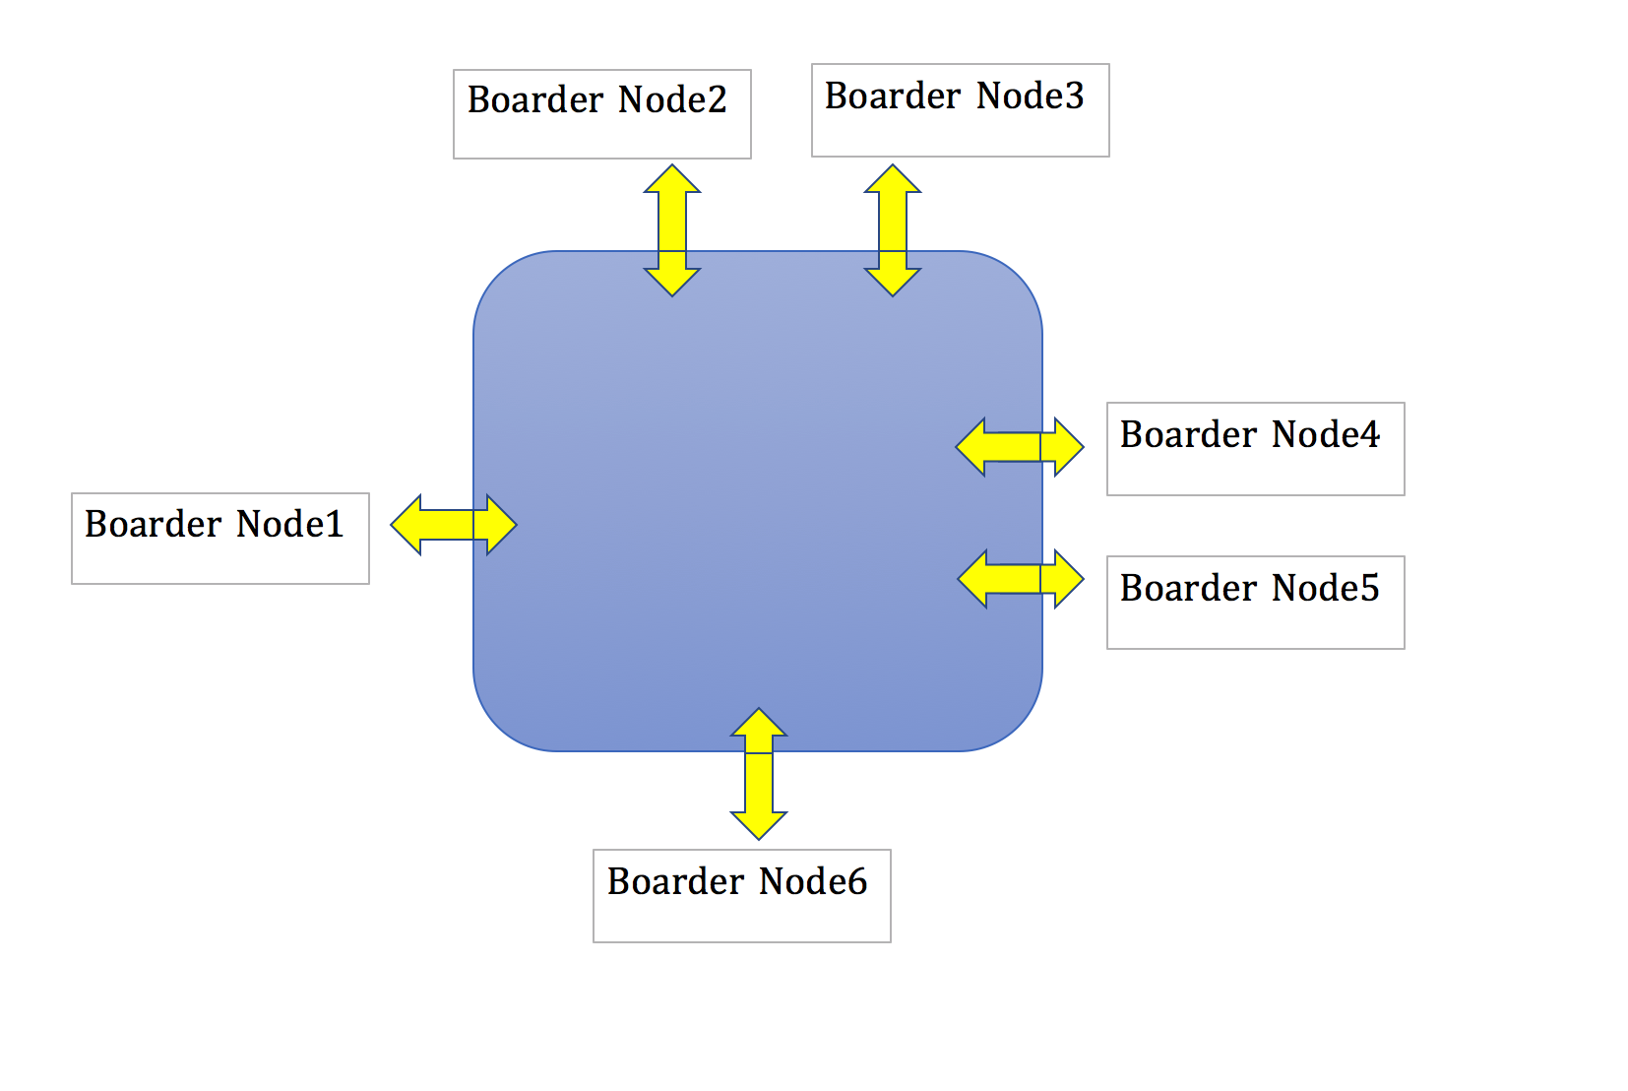
Notes:
https://ai.googleblog.com/2016/03/an-update-on-fast-transit-routing-with.html

Slide 39
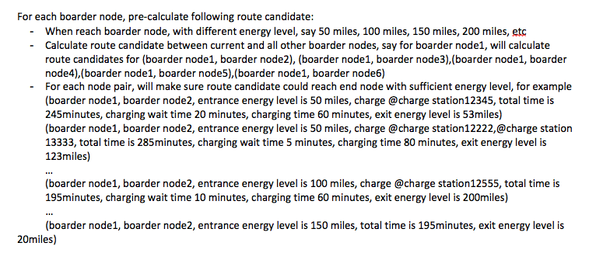
Pre-processing
Notes:
https://ai.googleblog.com/2016/03/an-update-on-fast-transit-routing-with.html

Slide 40
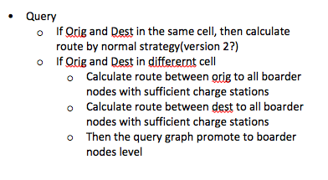
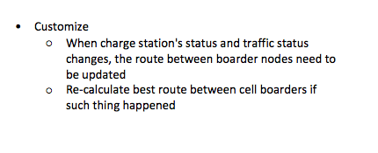
Query and Customize
Notes:
https://ai.googleblog.com/2016/03/an-update-on-fast-transit-routing-with.html

Slide 41
Future
- Dynamic information about charge station’s waiting time
- Best strategy for where to charge(Consider time to rest, meal, hotel, etc)
- Recommendation based on user’s preference
Notes:
https://ai.googleblog.com/2016/03/an-update-on-fast-transit-routing-with.html

Slide 42

When map is wrong (LYFT’s way)

